Slide 1

TWITTER DATA ANALYSIS FOR ILLINOIS HOSPITALS
By:
Krishangi Deka
Ipsita Ghatak
Shreya Gowda
Chaitra Venkateshaiah
Prasanna Vengatesh Venkataraman

Slide 2
Table of Contents
01
02
03
04
Project Goals
(Slide 3)
Approach
(Slide 5)
COVID Topic Analysis
(Slide 10)
Tools and Techniques
(Slide 13)
05
06
EDA and Results
(Slide 16)
Recommendations
(Slide 31)

Slide 3

PROJECT GOALS

Slide 4
Project Goals
Identify tweet-practices followed by hospitals in Illinois by analyzing their tweets during the COVID-19 pandemic
Identify factors that impact the traction of a tweet and recommend best tweet-practices to be followed by hospitals

Slide 5
APPROACH

Slide 6
Total Tweet Dataset
11,000+
Total number of Illinois Hospitals
Timeline
46
January 1 - September 30, 2020
Notes:
Total hospitals 58, but only 46 had tweets dated from jan to sept

Slide 7
Project Flow (Goal 1)
Collect tweets using Twint
Identifying topics
Manual classification of 20% of tweets into topics
Manual generation of keywords
Topic Modelling on all tweets using Anchored CorEx
Topic Modelling by Unsupervised CorEx
Data
pre-processing

Slide 8
Project Flow (Goal 2)
Data collection & compilation
Exploratory data analysis
Linear regression model
Future recommendations
Analyze variables that impact tweets

Slide 9
Impact of a Tweet
is measured by #RETWEETS and #LIKES it received
TWEET CHARACTERISTICS ORGANIZATIONAL CHARACTERISTICS
+ Tweet topic (from Goal 1) + Geographical Area
+ Time of Day + Number of followers on twitter
+ Day + Days since account creation
+ Media

Slide 10
COVID TOPIC ANALYSIS

Slide 11
Type of tweets under COVID Topics
Hospital specific COVID education:
Supporting front line workers
How to prevent spread of COVID-19
Encouraging people to get flu shot
COVID-19 vaccine
COVID specific event:
COVID-19 drive-through testing events
Events on vaccine clinical trials
Online events on safely returning to school and work
Online events on precautions and best practices to be taken to prevent spread of COVID-19
Online events on recovering from COVID-19

Slide 12
Type of tweets under COVID Topics
COVID Policy Changes:
COVID hotline
Visitor policy
Patient or visitor screening
General COVID Awareness:
CDC guidelines and recommendations
Traveling during COVID-19
How cancer patients can take extra precautions to protect themselves from COVID-19

Slide 13
TOOLS AND TECHNIQUES

Slide 14
Topic Modelling - Tools and Techniques
Twint
A Twitter scraping tool written in Python
Lemmatization
The process of reducing a word to its base form according to the dictionary meaning of the word
CorEx (Correlation explanation)
Finds coherent meaningful topics measured across a corpus of text
Un-Supervised and Semi-Supervised Learning
Unsupervised classification generates keywords for corresponding topics
Semi-Supervised classification, manually generated keywords are used for classifying data into topics

Slide 15
Regression - Tools and Techniques
Exploratory Data Analysis
Hypothesis testing used for finding significant variables in dataset
ANOVA
T-test
Pearson Correlation
Feature Selection is used for automatically selecting features most relevant to our prediction variable or output
Stepwise regression
Variance Inflation Factor (VIF)
Correlation Matrix
Linear Regression
Models a relationship between two sets of variables
Notes:
Anova test

Slide 16
EXPLORATORY DATA ANALYSIS AND
RESULTS

Slide 17
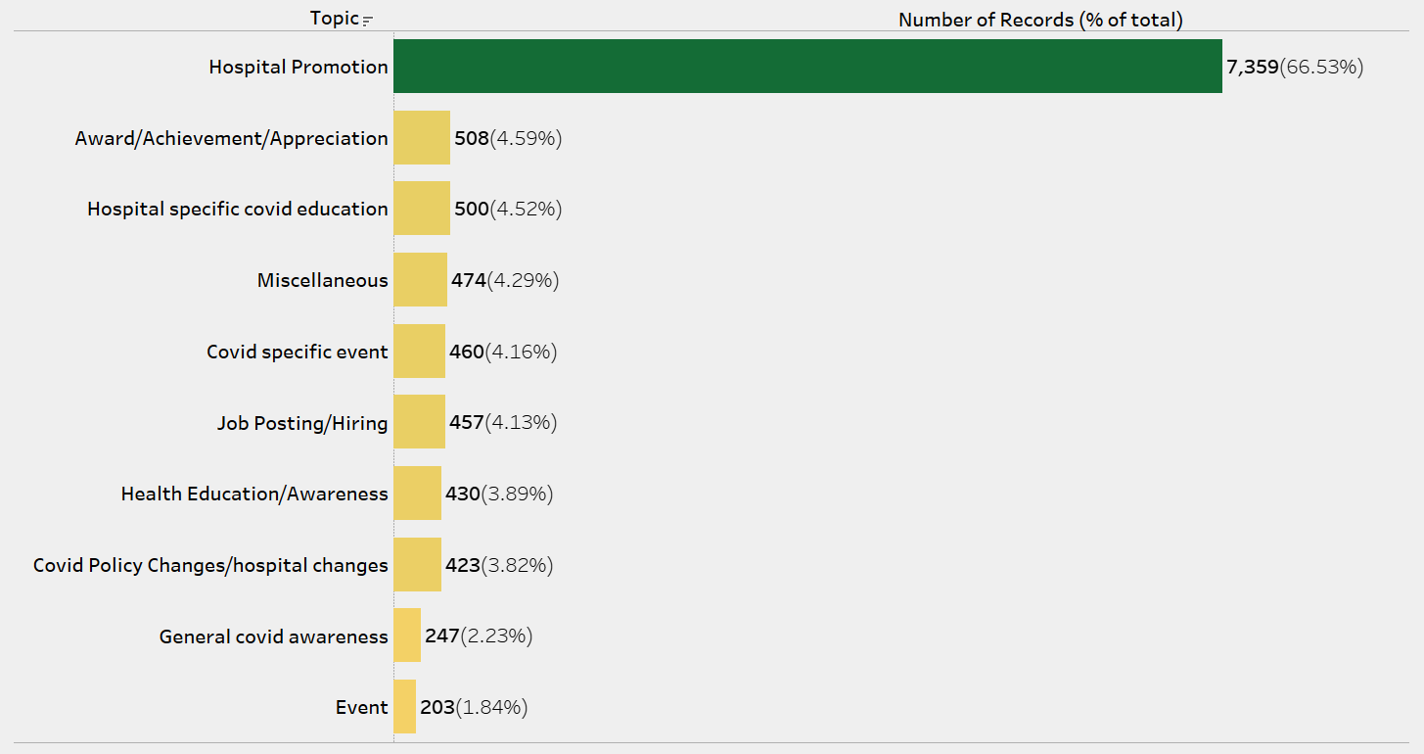
Topics Distribution

Slide 18
Observations - Topics
Two-thirds of tweets by Illinois Hospitals belong to the Hospital Promotion followed by Award/Achievement/Appreciation
Event is the least tweeted Topic
COVID related tweets are equally distributed between Hospital specific COVID education and COVID specific event
General COVID awareness is the least tweeted COVID Topic

Slide 19
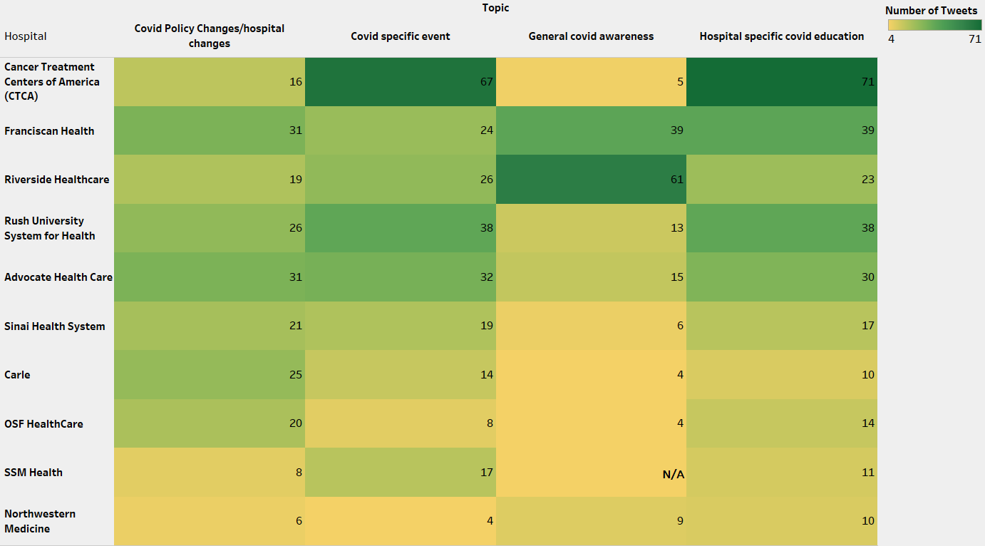
COVID Tweet Counts
Note: The count is in descending order of total COVID tweets per hospital, filtered by the top 10 count values.

Slide 20
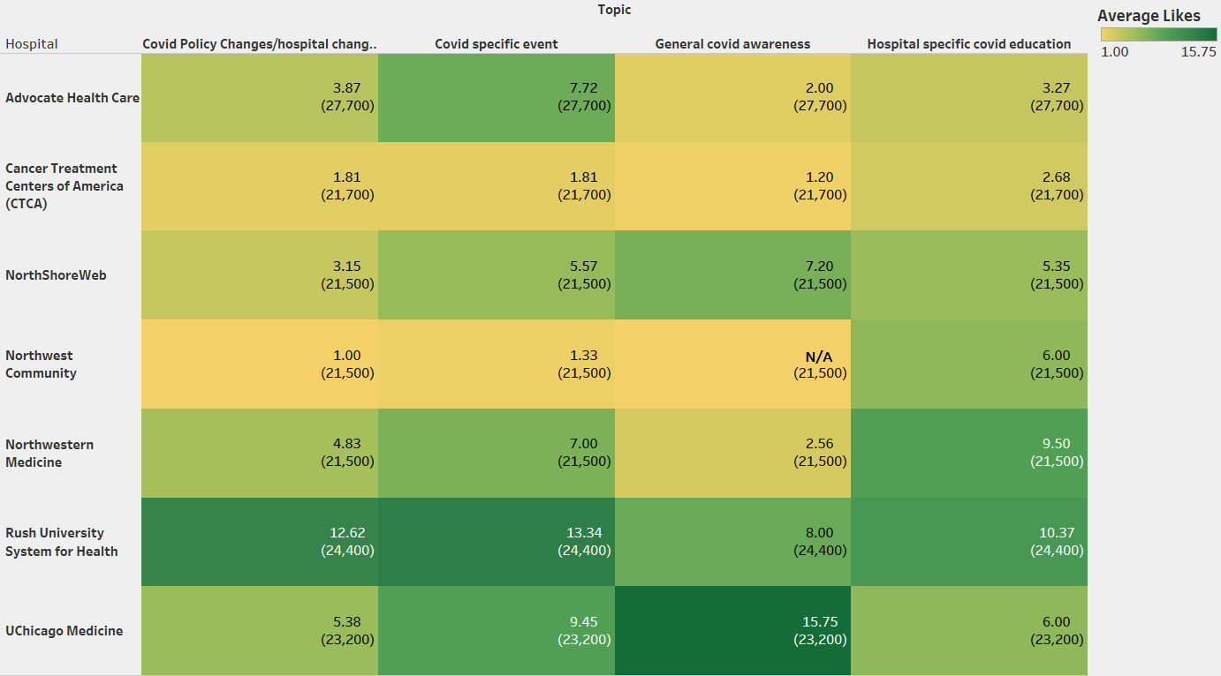
Average Likes for COVID Tweets
Note: Values in brackets are number of followers for each hospital > 20k

Slide 21
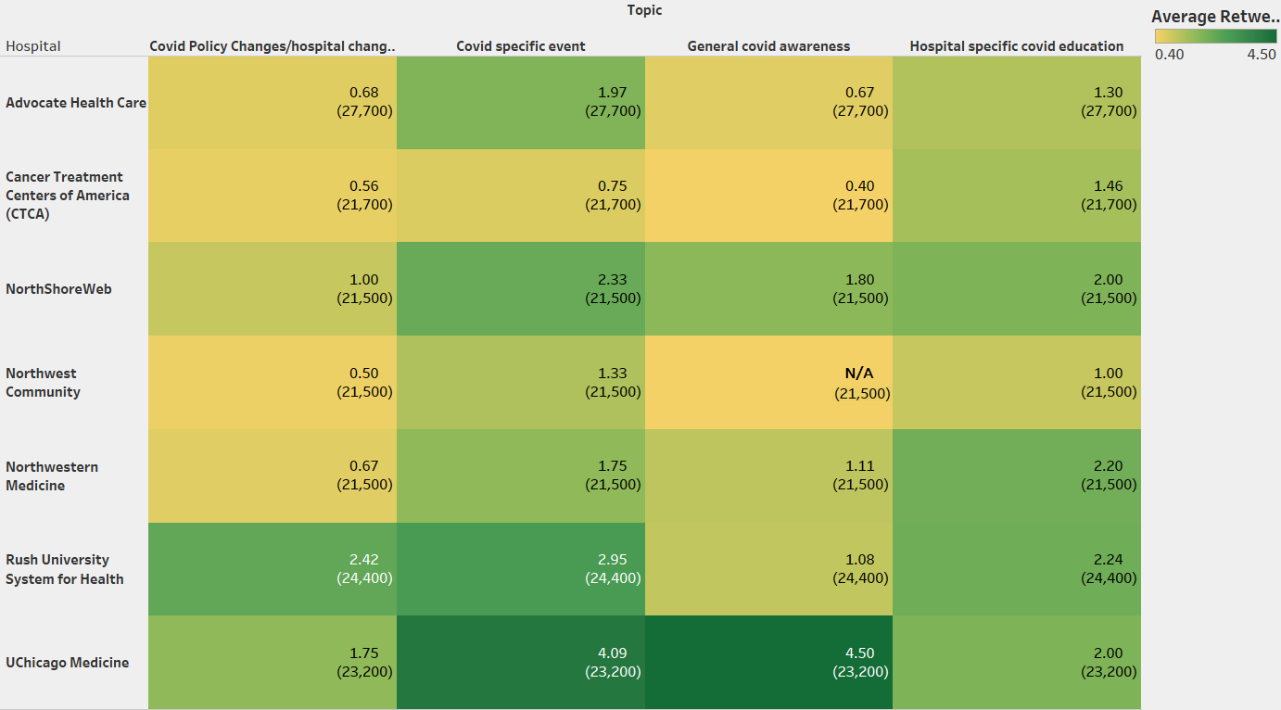
Average Retweets for COVID Tweets
Note: Values in brackets are number of followers for each hospital > 20k

Slide 22
Observations - COVID Tweets
COVID specific event and Hospital specific COVID education are the most frequently tweeted COVID topics
Both topics above receive the highest number of likes and retweets
The average of Likes is 3.21 and average of retweets is 1.01 for the overall dataset

Slide 23
Observations - Hypothesis Testing
 | Statistically Significant | Statistically Insignificant
ANOVA | Topic (5.69e-11, 1.35e-5) | Time of Day (0.861, 0.700)
t-Test | - | Day (0.529, 0.973) Geographical Area (1.0, 1.0)
Pearson | Days since account creation (3.601e-18, 5.767e-13) Number of Followers (4.01e-75, 1.781e-54) | -
Note:
Values inside brackets indicate the probabilities (or p-value) of the variable with respect to likes and retweets respectively
All variables are checked for statistical significance at 95% confidence interval

Slide 24
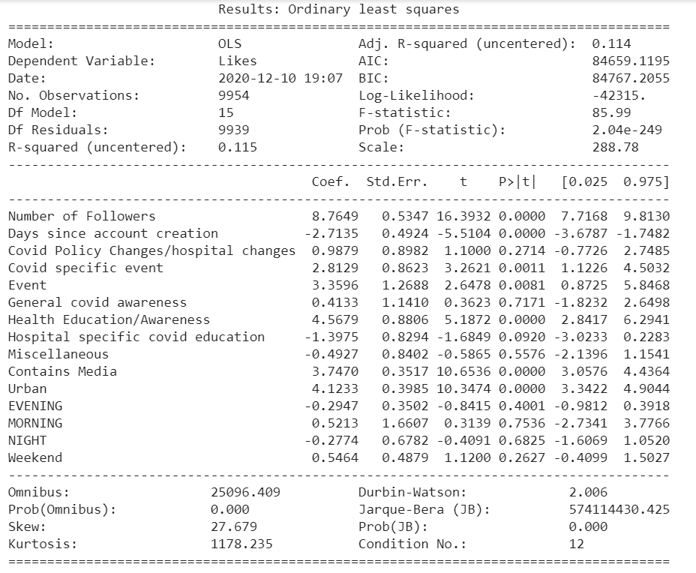
Linear Regression - Likes

Slide 25
Observations: Linear Regression - Likes
Adjusted R-squared value has increased from 0.059 (using all variables) to 0.114 (chosen variables), therefore, the variables chosen have significantly improved the model.
AIC has decreased from 93087.734 to 84659.1195 indicating that the regression model has improved prediction accuracy.
Variables statistically significant at 95% confidence interval are:
Number of followers
Days since account creation
COVID specific event
Event
Health Education/Awareness
Contains Media
Urban

Slide 26
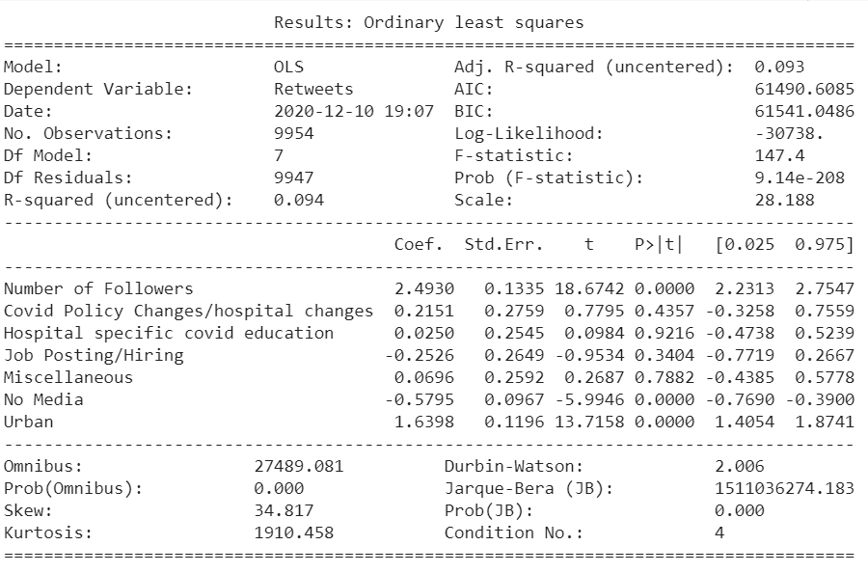
Linear Regression - Retweets

Slide 27
Observations: Linear Regression - Retweets
Adjusted R-squared value has increased from 0.059 (using all variables) to 0.093 (chosen variables), therefore, variables chosen have significantly improved the model.
AIC has decreased from 67376.358 to 61490.6085 from that of the previous which indicates that the model has improved prediction accuracy.
Variables statistically significant at 95% confidence interval are:
Number of followers
No media
Urban

Slide 28
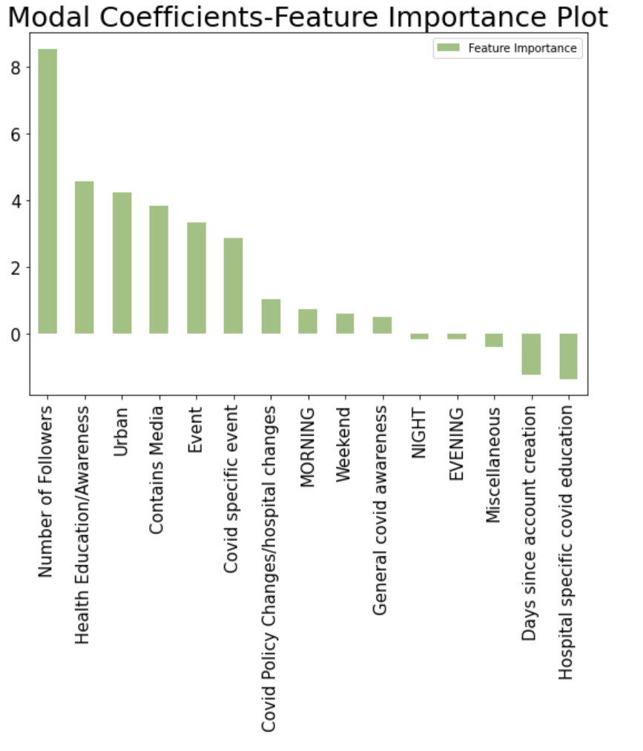
Feature Importance - Likes
Important Features with positive coefficients in predicting Likes are:
Number of followers
Health Education/Awareness
Urban
Contains Media
Event
COVID Specific Event
COVID Policy Changes/hospital changes
Morning
Weekend
General COVID Awareness
Note: Feature Importance assigns a score to input features based on their usefulness in predicting a variable

Slide 29
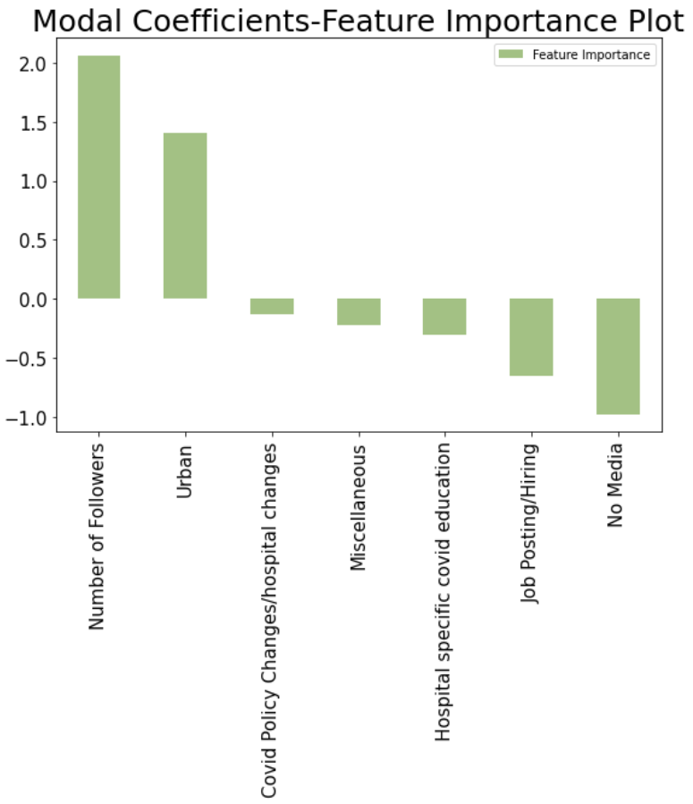
Feature Importance - Retweets
Important Features with positive coefficients in predicting Retweets are:
Number of followers
Urban
Note: Feature Importance assigns a score to input features based on their usefulness in predicting a variable

Slide 30
Overall Analysis
Features which seem to have a higher user engagement:
Contains Media
COVID specific event
Health Education/Awareness
Urban
Features which seem to have a lower user engagement:
Hospital specific COVID education
Miscellaneous
Job Posting/Hiring

Slide 31
RECOMMENDATIONS

Slide 32
Recommendations
COVID related tweets
Focus on tweeting about COVID Specific Event
Increasing User engagement
Include media in tweets
Focus on tweeting about Health education/Awareness, Event
Increase followers
Negative impact on User engagement
Miscellaneous and Job posting/hiring tweets
Advertising the hospital
Reduce direct promotional tweets
Focus on tweeting about Health education/Awareness and Event

Slide 33
Thank You.

